Slide 1
Computer Architecture

Slide 2

In this Lecture
Different computer hardware and their functions
Processor
Memory
Buses
I/O
Interrupts
Notes:
Explain what the components are. Emphasis Kernel, and interrupt.
2

Slide 3
The Computer Architecture
Data Bus
Processor
Memory (ROM/RAM)
I/O Devices
Clock
Address Bus
Control Bus
Notes:
Explain what the components are. Emphasis Kernel, and interrupt.
3

Slide 4
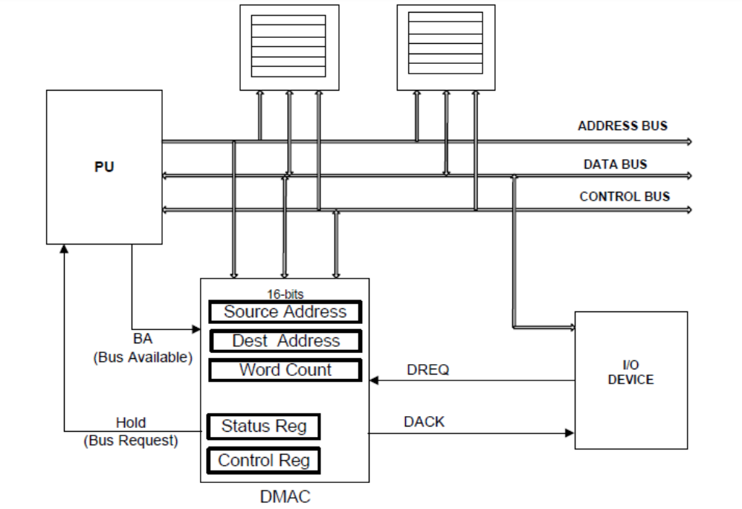
Basic Computer Architecture
It is a 16 bit register that stores the number of transfers to be performed during an operation
The status register is a hardware register that contains information about the state of the processor.
A control register is a processor register which changes or controls the general behavior of a CPU or other digital device. Common tasks performed by control registers include interrupt control, switching the addressing mode, paging control, and coprocessor control
Notes:
Explain what the components are. Emphasis Kernel, and interrupt.
4

Slide 5
General Microprocessor
In a simple embedded system
The processor is the heart of the system – controlling all other circuits
Processor communicates via buses
In a desktop PC
buses may be more complicated
Same main types, but different levels operating at different speeds
Notes:
Explain what the components are. Emphasis Kernel, and interrupt.
5

Slide 6
Buses
Main means of communication within a processor system
Each bus is a collection of similar signals
These are usually carried on copper tracks in a motherboard
Control Bus
Collection of signals, mainly from processor that control rest of the system
Example. it may send a signal to read from memory chips, or write to an I/O device
Address Bus
Use to select a particular chip, and location within a chip that it is to be used
Data buses
Used to transmit data from one point to another. Some multiple of 8 bits typically sent at a time
Notes:
6

Slide 7
Fetch (Decode) Execute Cycle
The Processor continually fetches instructions from memory
This is driven by the clock
A special register, called the Program Counter, or Instruction Pointer holds the address of the next instruction
Address being the location in the memory
The fetched instruction is then executed. This may involve arithmetic, storing results, making decisions, etc.
This is known as Fetch – Decode – Execute cycle.
Notes:
7

Slide 8
Instruction execution review
Executing a MIPS instruction can take up to five steps.
SLNO | Step | Name | Description
1
2
3
4
5
Instruction Fetch
IF
Read an instruction from memory
Instruction Decode
ID
Read resource register and generate control signals
Execute
EX
Compute an R type result or a branch outcome
Memory
MEM
Read or write the data memory
Write Back
WB
Store the result in the destination register

Slide 9
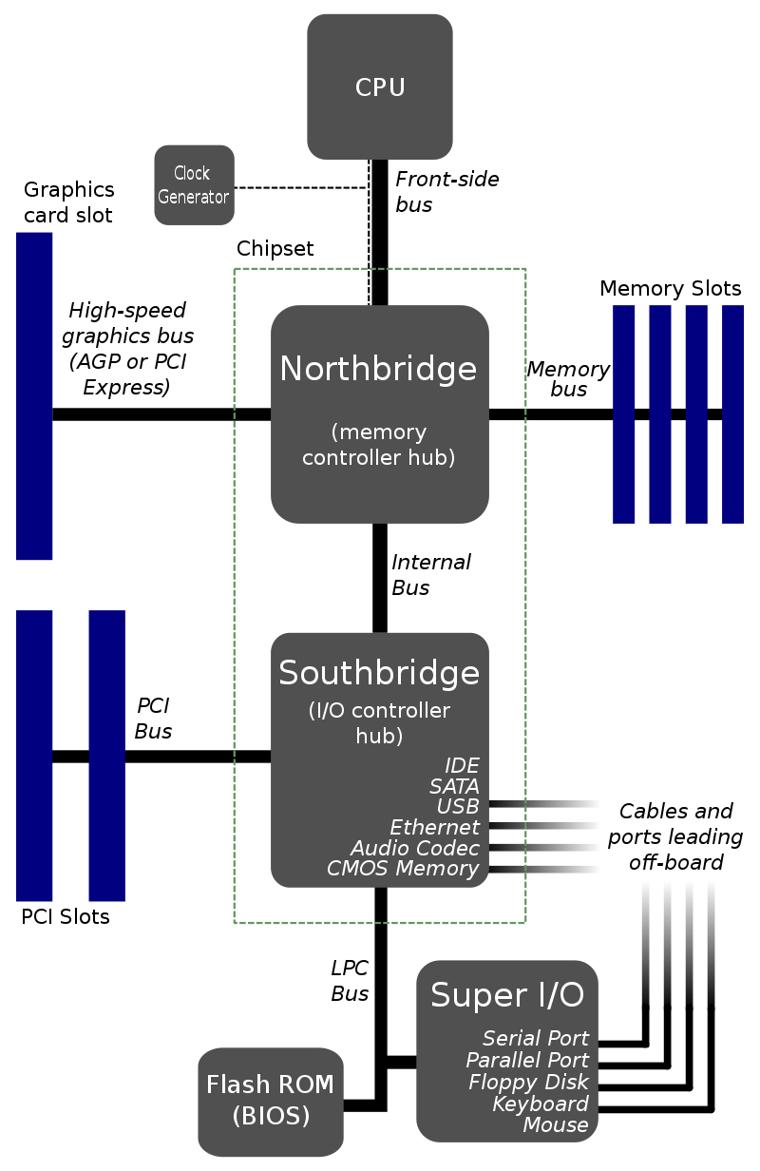
North/South Bridge Architecture
Example of the hierarchal nature of buses
Classic computer architecture included two “Bridge” to control buses
High-speed North Bridge connects CPU to memory and PCI-E connection
Relatively lower speed South Bridge connects to BIOS, Serial Ports, etc.
This includes Ethernet connections
Complementary Metal Oxide Semiconductor
Accelerated Graphics Port
Peripheral Component Interconnect
Notes:
9

Slide 10
Cache is graded as Level 1 (L1), Level 2 (L2) and Level 3 (L3):
L1 is usually part of the CPU chip itself and is both the smallest and the fastest to access. Its size is often restricted to between 8 KB and 64 KB.
L2 and L3 caches are bigger than L1.
They are extra caches built between the CPU and the RAM.
Sometimes L2 is built into the CPU with L1.
L2 and L3 caches take slightly longer to access than L1.
The more L2 and L3 memory available, the faster a computer can run.
Not a lot of physical space is allocated for cache. There is more space for RAM, which is usually larger and less expensive.
Each CPU core has its own L1 cache, but may share L2 and L3 caches.
Notes:
Explain what the components are. Emphasis Kernel, and interrupt.
10

Slide 11
Example for Accessing Ram
RAM 1
Address Bus
Processor
Control Bus
Data Bus
Address and control signals are set-up
The RAM fetches the data from the correct location
The data is sent to the processor using the data bus
RAM 2
 | 2
Notes:
11

Slide 12
Hub Chips (Bridges
Memory Module
Processor Chip
RAM 1
Processor
Hub Chip
RAM2
Cache
Notes:
12

Slide 13
Multicore CPU Architecture
As computers with more and more transistors, more high-speed memory is needed to utilise it.
Multi-core CPU architectures allow for this by using caches within the processor chip
Processor Chip
CPU 0
CPU 1
L2 Cache
L2 Cache
L3 Cache
Interface to Front Bus
Memory Controller
RAM
Notes:
13

Slide 14
Multicore CPU Architecture
Multicore CPU architectures replicate not just control logic, but the whole core
The majority of memory transfer is done between cached memory
This reduces the load on the “North-bridge” bus
Note: The North-Bridge functions are increasingly being integrated into the Processor itself – rather than as a separate chip.
Multiple cores share the same system bus and I/O resources
Cores can be controlled independently
Modern computers are starting to use big dot little designs
Many efficient, low powered cores for background tasks
A few large, powerful cores for more intensive applications
Notes:
14

Slide 15

Processes and Interrupts

Slide 16
Processes
Difference between processes and:
Programs
Threads
Interrupts
Notes:
Explain what the components are. Emphasis Kernel, and interrupt.
16

Slide 17
Processes
A program is not always running
It can therefore be considered “passive”
A process is an instances of a program in execution
Instances of a program – You can have multiple processes of the same program (i.e. multiple instances)
In execution – The process is actively being executed.
It is therefore considered “active”.
Notes:
Explain what the components are. Emphasis Kernel, and interrupt.
17

Slide 18
What is in a Process?
A process contains the following:
Program Counter (PC) – Register with address of next instruction
Contents of the processor’s registers
Values of variables
Process stack
Typically contains temporary data such as subroutine parameter, return address, and temporary variables
Notes:
18

Slide 19
Stack Memory
An area of RAM that operates as a Last-in-First Out memory
Used to store dynamically generated data
Used during interrupt processing to preserve processor status
Register values (PC, Status flags, etc.) “pushed” to the stack, then “popped” back from the stack
Notes:
19

Slide 20
Process Trees
Operating systems need a way to create and terminate processes
“Parent processes” should be able to create “child processes”
Which should in turn, be able to create their own “child processes”.
This forms a tree of processes.
Notes:
Explain what the components are. Emphasis Kernel, and interrupt.
20

Slide 21
Process
B1
B2
C1
C2
C2

Slide 22
Process Management - Threads
Processes can be managed by dividing parts of the process into threads.
A process may have just one thread, or many
Modern computers can perform multi-threaded processes faster than single threaded processes
Process
Thread 3
Thread 2
Thread 1
Notes:
22

Slide 23
Similarities between threads and processes
Only one instance of either can be active (running) at a time per CPU
Both have their own logic control flow
Both can run concurrently on different processors.
Both threads and processes can create child threads/processes
Both have their own Stack
Notes:
23

Slide 24
Differences between a thread and a process
Process
Thread (within a process)
SL NO | Thread | Process
1
2
3
Processes have isolated memory
Threads (within a process) share memory
Processes tend to be larger than threads (most processes have multiple threads)
A thread is the smallest sequence of instructions that can be scheduled within a process
Take longer to create/delete/change context
Take less time to create/delete/change context
Notes:
24

Slide 25
Differences between a thread and a process - Continued
SL NO | Process | Thread (within a Process)
1
2
If one process is blocked, the execution of other processes is not affected
A second thread in the same task cannot run while one server thread (something that needs to “serve” [send] data) is blocked
Processes have their own Process Control Block
Threads have the parent process’s PCB.
Notes:
25

